Slide 1

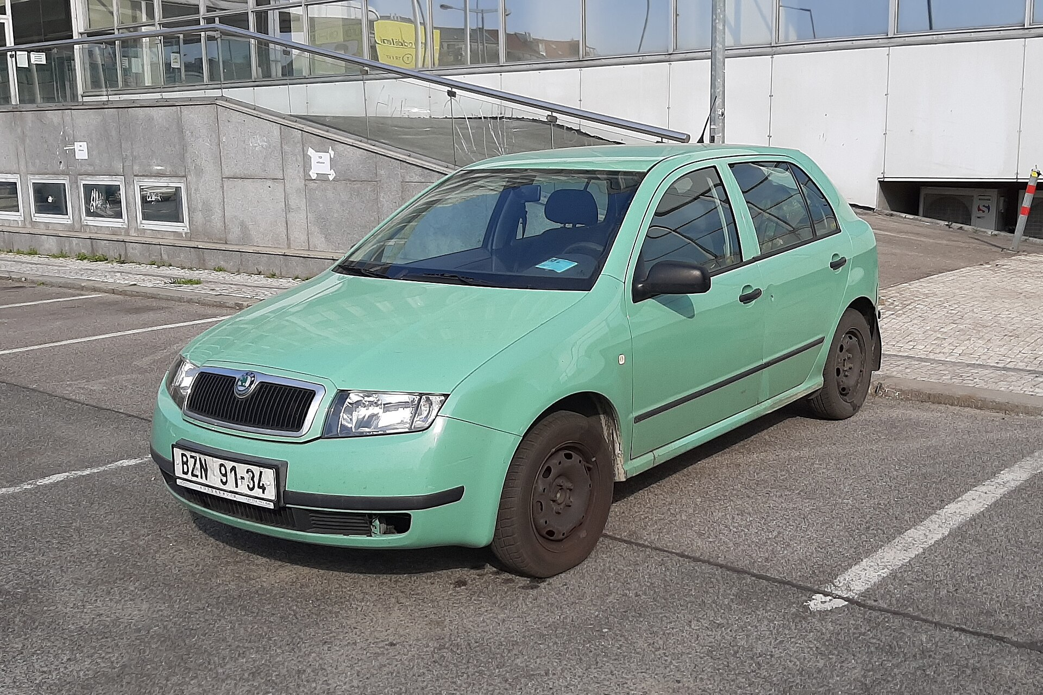
Why are green cars bad?
Václav Kožený

Slide 2

Why are green cars bad?
Václav Kožený

Slide 3
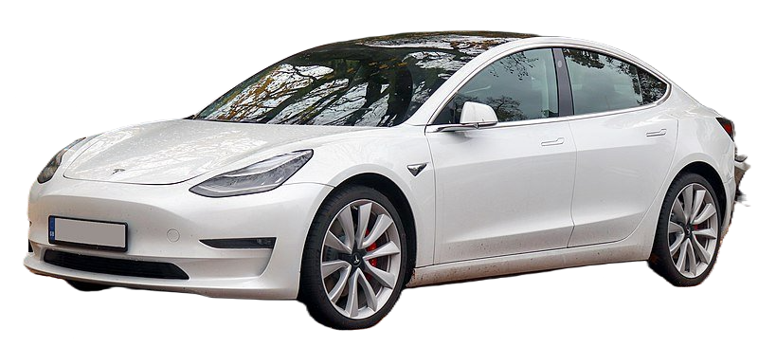






Content
Generation of electricity
Raw materials
Batteries
Manufacturing
Market

Slide 4
Keywords
electric vehicles (EV) – vehicle propelled by electricity
internal combustion engine (ICE) – engine that runs on fossil fuel
renewable source – source that doesn't relay on earth resources
artisanal mining – mining without machinery
rare earth elements (REE) - set of 17 silvery-white soft heavy metals used for manufacturing modern technologies
efficiency – relationship between input and output energy
import tariffs – you pay more if you buy foreign goods

Slide 5


How many percent of electricity is considered "clean" in Czechia?
100 %
50 %
10 %

Slide 6
How many percent of electricity is considered "clean" in Czechia?
100 %
50 %
10 %

Slide 7




Where does electricity come from?
40.3 %
36.2 %​
13.8 %
9.5 %
Czech Republic, 2021
Notes:
Burnig coal is the worst source of electricity
Renewable
Water
Wind
Solar
Biomas
Biogas

Slide 8


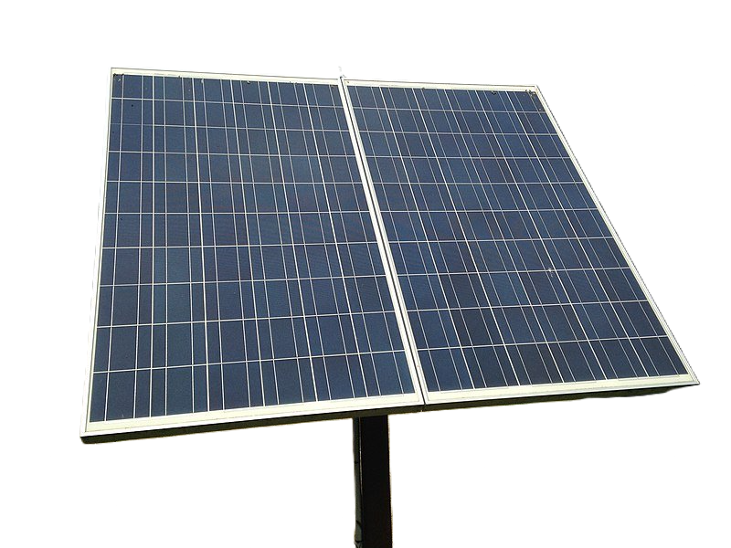
Is renewable good?
Unstable
Not carbon neutral
Use much more raw materials
Source of social and environmental conflicts
Notes:
Yes and no
building solar plants, wind farms and EVs generally requires more minerals than their fossil fuel-based counterparts
Copper
silicon
Mainly when building dams, also mining for recources

Slide 9
Is renewable good?
Unstable
Not carbon neutral
Use much more raw materials
Source of social and environmental conflicts
Notes:
Yes and no
building solar plants, wind farms and EVs generally requires more minerals than their fossil fuel-based counterparts
wind plant requires nine times more mineral resources than a gas-fired power plant
Copper
silicon
Mainly when building dams

Slide 10
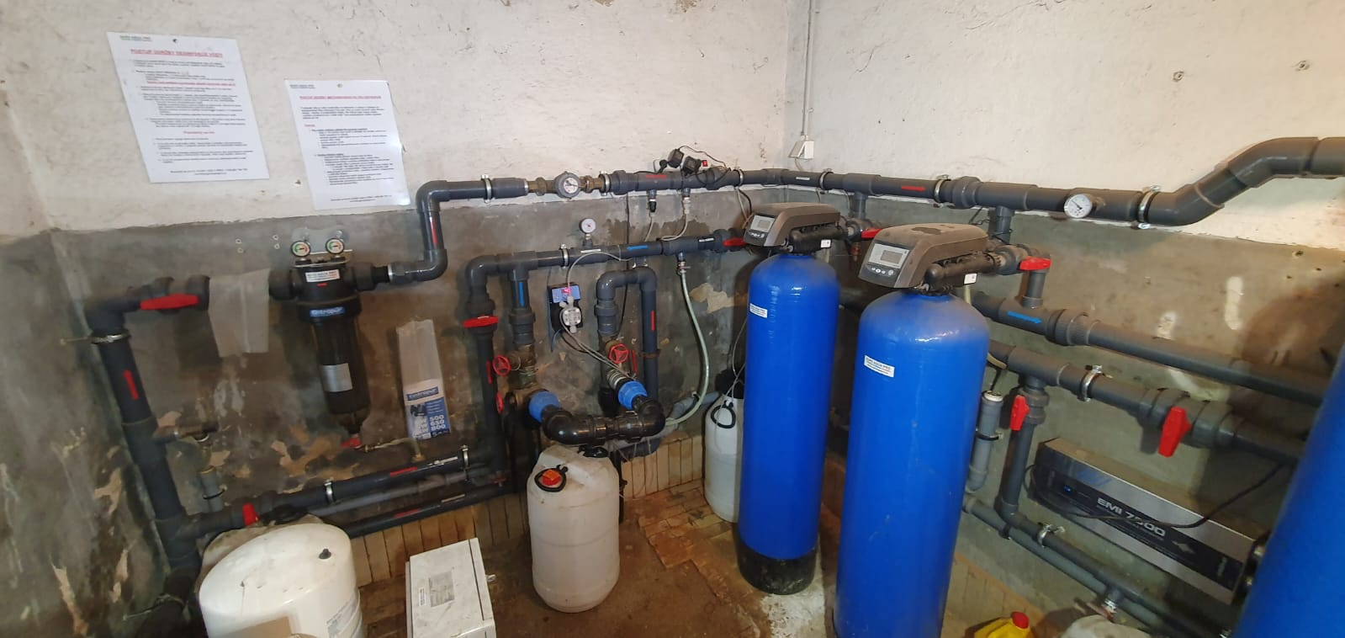

Slide 11
Mining for raw materials
EVs use 6x more minerals then ICEVs [1]
Children works in mines
Workers aren't paid fairly
Mining isn't great for environment
Notes:
Minerals
Copper
Cobalt
Nickle
REE
Lithium

Slide 12
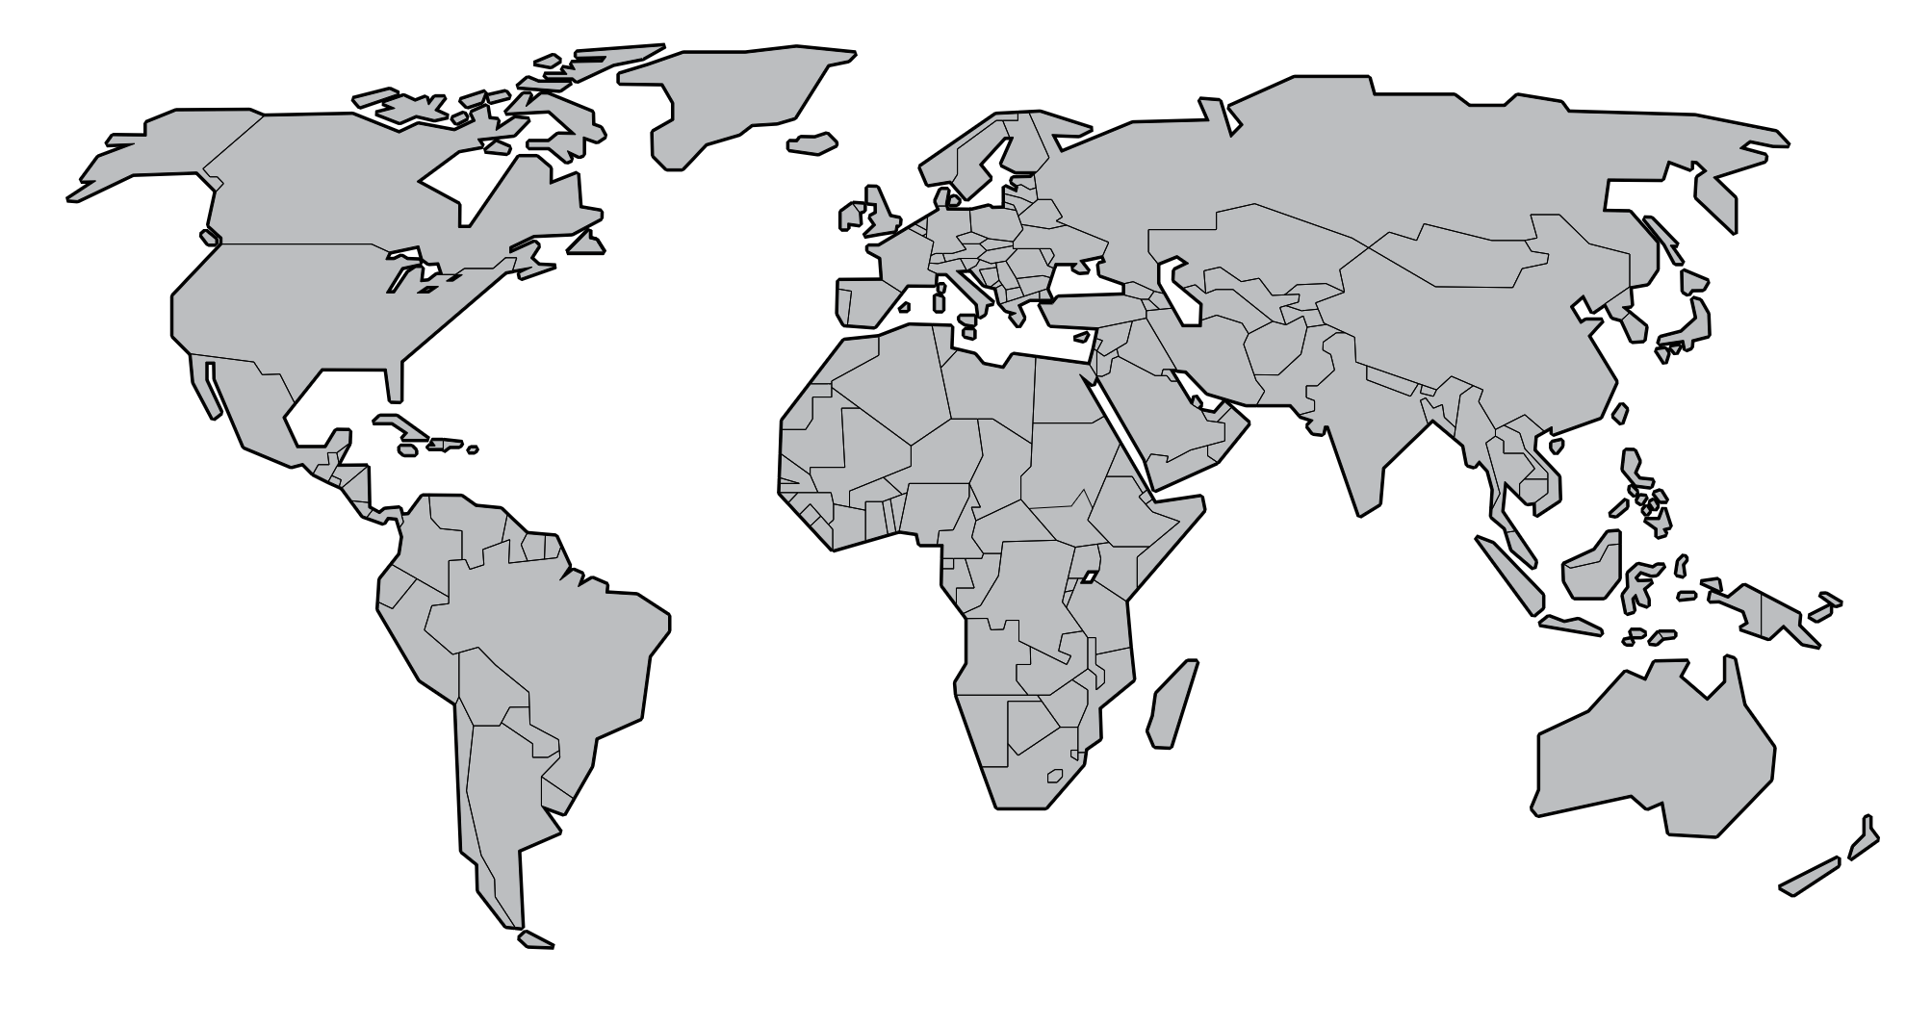

Slide 13


Slide 14



Modern day slavery [3]
Some cobalt is mined in artisanal mines
using shovels and pickaxes
in a tiny mining tunnels
with almost no wages
Cobalt is toxic to touch
Children are trafficked to work in mines

Slide 15
Environmental impact
Pollutes water, air and land around mines
13 Kg of REE produces [2]
~10,000 m³ of waste gas
~75 m³ of wastewater
1 ton of radioactive residue
Notes:
mainy neodymium -> magnets for electirc motors

Slide 16
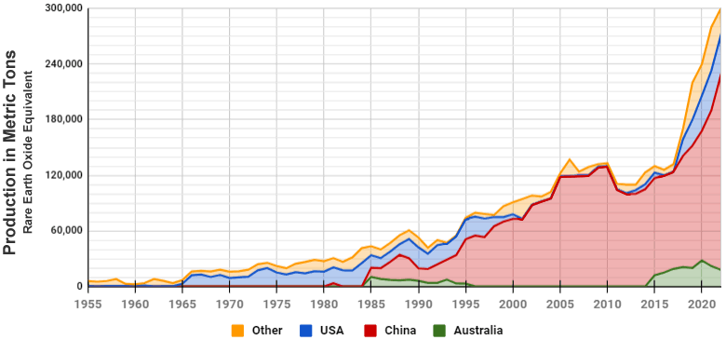
Notes:
2023 – sweden anounced Discovery of Europe largets REE deposit
its not all lost for our freedom friends, becouse in 2023 sweden discovered giant vein fo REE
estimated 1 000 000 tons

Slide 17

Notes:
its not all lost for our freedom alie, becouse in 2023 sweden discovered giant vein fo REE
estimated 1 000 000 tons

Slide 18
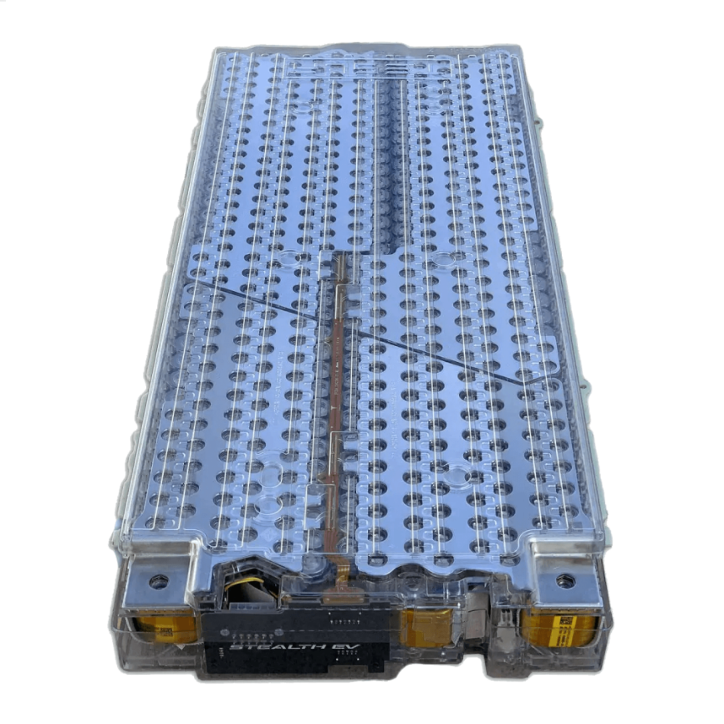
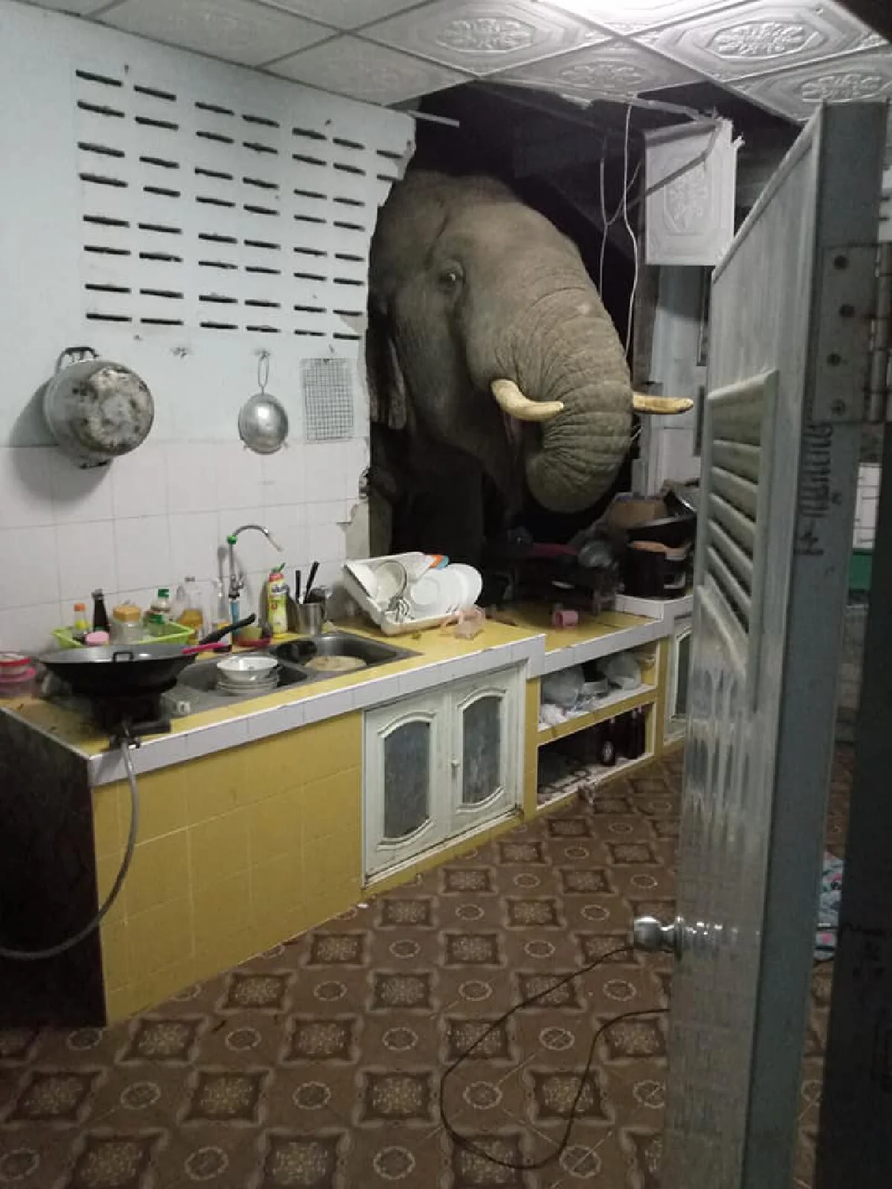
Notes:
lets talk aobou elephant in the room - Batteries

Slide 19



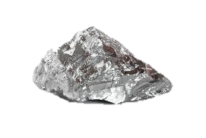
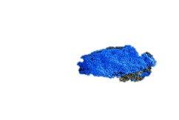
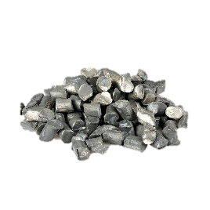

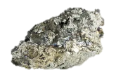
Notes:
lithium form Chille
cobalt from DRC (democratic republic of congo)
manganese from South Africa
Nickel from Indonesia
Battrey goes to Tesla GigaFactory in Germany

Slide 20
Typical battery use [4]:
Lithium: ~8 Kg
Cobalt: ~14 Kg
Manganese: ~20 Kg
All those materials have to be refined and purified
chemical and (sometimes) radioactive waste

Slide 21
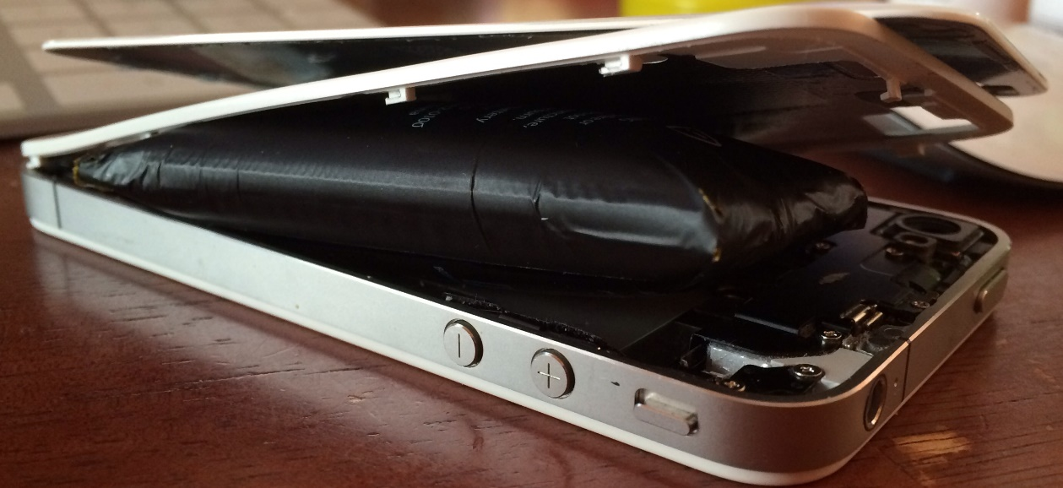
What should John do with his old battery?
Throw it into the sea
Recycle it
Leave it at landfield
Notes:
Degrades over time

Slide 22
What should John do with his old battery?
Throw it into the sea
Recycle it
Leave it at landfield

Slide 23
Recycling batteries
Recycling is limited
Cobalt
Nickel
Pyrometallurgy – melt batteries -> extract CO, NI
Hydrometallurgy – dissolve batteries in acid -> more efficient
Mechanical recycling – magnetically separated, sorting by density

Slide 24
Making EVs
Easier to make
Less moving parts
Electric engines need REE
Longer and more complex supply chain
Notes:
Easier to make
could lead to layofs in Europe
modern Europe was basicaly build by car making industry

Slide 25
EVs vs ICEVs
EVs are more efficient (~90% vs ~40%)
EVs range is lower
Charging take more time (significantly)
EVs are heavier -> more "wear and tear" of infrastructure

Slide 26
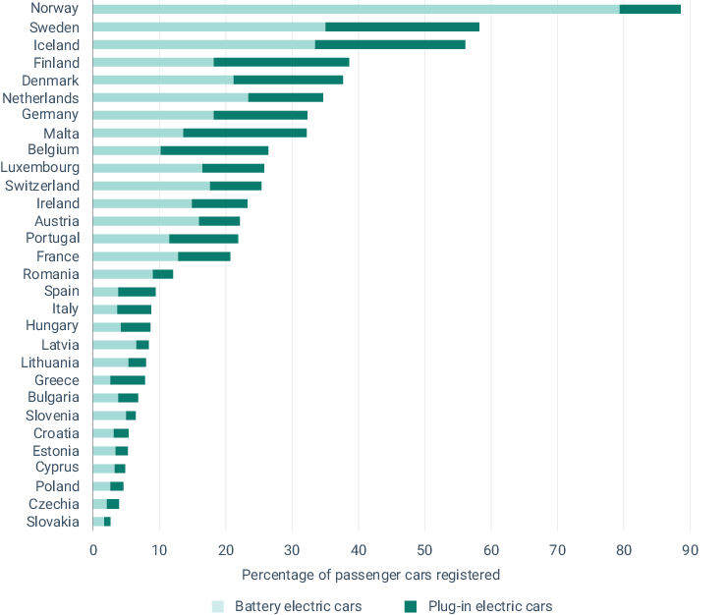
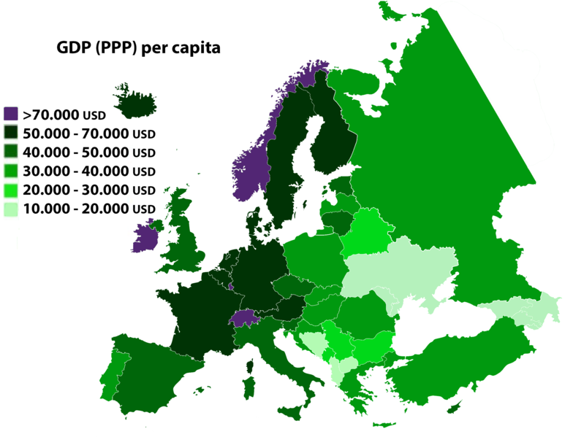

Slide 27
Market
EVs are more expensive (compare to ICEVs)
EU imposed tariffs on Chinese EVs (35%)
BYD becoming one of the largest EV manufacturer
You can get up to 300k CZK to buy new EV
you must be entrepreneur
There is little interest among normal people
and it‘s getting lower
Notes:
EU imposed tariffs on Chinese EVs
I see it as intervention in the free market
instead of making Europe EVs cheaper they made cheaper cars (from China) more expensive

Slide 28



Questions
Would you like to own an electric car in the future? Why?/Why not?
Do you think there is enough discussion about the overall impact of electric cars on the environment, or is this debate rather one-sided?
What do you think are more environmentally friendly alternatives to electric cars?
How should the issue of battery recycling from electric cars be addressed to ensure their sustainability?
Do you think the economic favoring of electric cars is fair to other modes of transport that can also be ecological?
Should government support for electric vehicles be limited if they are not environmentally sustainable? Why yes/no?
Notes:
Would you like to own an electric car in the future? Why?/Why not?
Do you think there is enough discussion about the overall impact of electric cars on the environment, or is this debate rather one-sided?
What do you think are more environmentally friendly alternatives to electric cars?
How should the issue of battery recycling from electric cars be addressed to ensure their sustainability?
Do you think the economic favoring of electric cars is fair to other modes of transport that can also be ecological?
Should government support for electric vehicles be limited if they are not environmentally sustainable? Why yes/no?

Slide 29
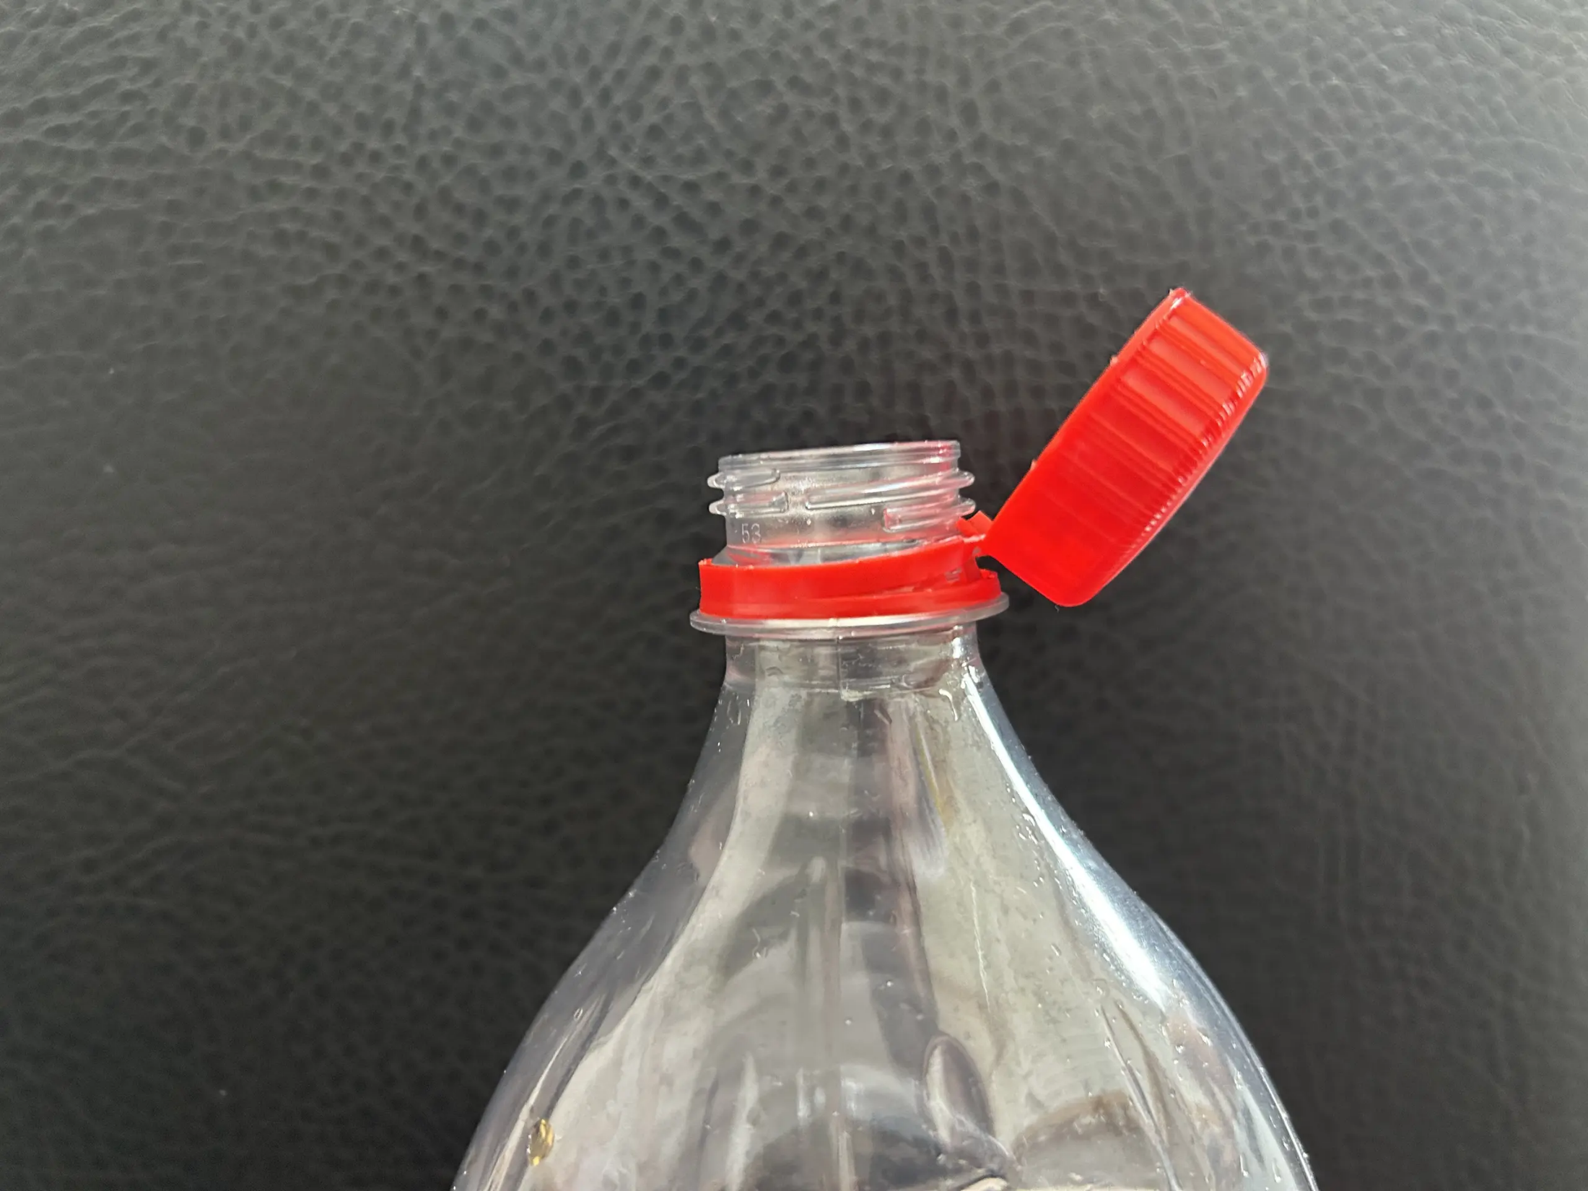
Notes:
How is this saving planet?

Slide 30
Do you have any questions?

Slide 31
Source articles
[1] Kish, R. (2023). Are electric vehicles really green? Economic Affairs, 43(2), 275–286. https://doi.org/10.1111/ecaf.12582
[2] Nayar, J. (2021). Not So “Green” Technology: The Complicated Legacy of Rare Earth Mining. Harvard International Review. https://hir.harvard.edu/not-so-green-technology-the-complicated-legacy-of-rare-earth-mining/
[3] Gross, T. (01.02.2023). How 'modern-day slavery' in the Congo powers the rechargeable battery economy, National Public Radio. https://www.npr.org/sections/goatsandsoda/2023/02/01/1152893248/red-cobalt-congo-drc-mining-siddharth-kara
[4] EVBox, (04.05.2023), Are electric car batteries bad for the environment?, https://blog.evbox.com/ev-battery-environmental-impact

Slide 32
Sources
https://cs.wikipedia.org/wiki/Energetika_v_%C4%8Cesku
https://cs.wikipedia.org/wiki/Obnoviteln%C3%A1_energie

Slide 33
Image / videos sources
Autor: Jan Polák – Vlastní dílo, CC BY-SA 3.0, https://commons.wikimedia.org/w/index.php?curid=89896908
https://www.youtube.com/watch?v=7iOOiYmSOt8
Vauxford, CC BY-SA 4.0, via Wikimedia Commons https://upload.wikimedia.org/wikipedia/commons/9/91/2019_Tesla_Model_3_Performance_AWD_Front.jpg
MarkBuckawicki, CC0, via Wikimedia Commons https://upload.wikimedia.org/wikipedia/commons/7/7a/Solar_Panel_.jpg
Hobart M. King, via geology.com https://geology.com/articles/rare-earth-elements/rare-earth-elements-production-history.gif
European Environment Agency, via www.eea.europa.eu https://www.eea.europa.eu/data-and-maps/figures/new-electric-vehicles-by-country-2/fig2-257004-term034-v3.eps/FIG2-257004-TERM034-v3.eps.75dpi.png
Fandom, via minecraft.fandom.com,
https://static.wikia.nocookie.net/minecraft_gamepedia/images/d/d8/Plains_Villager_Base.png/revision/latest?cb=20231225162655
https://static.wikia.nocookie.net/minecraft_gamepedia/images/e/e7/Diamond_Pickaxe_JE3_BE3.png/revision/latest?cb=20200226193952
https://static.wikia.nocookie.net/minecraft_gamepedia/images/e/ec/Diamond_Shovel_JE3_BE3.png/revision/latest?cb=20200226194003

Slide 34
afingolingo, Nerd Nerd Emoji GIF, Tenor, 15.03.2024, https://tenor.com/cs/view/nerd-nerd-emoji-gif-1712163874519931175
realquandaledingle, Yapdollar Yap-dollar Sticker, Tenor, 07.10.2024, https://tenor.com/cs/view/yapdollar-yap-dollar-yapp-dollar-fiveish-memes-gif-11288090867046034060
impastau, Cotton Eye Joe Gegagedigedagedago Sticker, 03.05.2024, https://tenor.com/cs/view/cotton-eye-joe-gegagedigedagedago-gega-gedi-geda-gif-17492333705643709907
Ahtisham Ul Hayat, via www.vecteezy.com, https://www.vecteezy.com/video/27244189-eagle-flying-green-screen-video-5
Magnicello, via www.reddit.com/r/funny, https://www.reddit.com/media?url=https%3A%2F%2Fpreview.redd.it%2Fmh1lcndqce671.jpg%3Fwidth%3D640%26crop%3Dsmart%26auto%3Dwebp%26s%3Da2314c27671bb6f05d4f1cb3198f18930a0c002e
www.rawpixel.com, https://www.rawpixel.com/image/6815381/png-face-aesthetic
stealthev.com, Tesla 5.3 kWh Battery Module (85 kWh Pack), https://stealthev.com/wp-content/uploads/2019/03/Tesla-battery-module-front-angle-1-1000x1000.png
Jakub Coufal, via medium.seznam.cz, https://d8-a.sdn.cz/d_8/c_imgrestricted_QN_L/4XWNK/ekologie-spolecnost-eu-zdravi-recyklace.jpeg?fl=cro,0,0,4032,3024%7Cres,2560,,1%7Cwebp,75
redakce, via www.cojeco.cz, lithium, https://www.cojeco.cz/images/descript/233faa34623413a9a7d9a12857a12115.jpeg
-, via geologyscience.com, Cobalt (Co) Ore, https://i0.wp.com/geologyscience.com/wp-content/uploads/2023/04/blue-cobalt-rocks.webp?resize=640%2C427&ssl=1
The Editors of Encyclopaedia, via Britannica, manganese, https://cdn.britannica.com/75/126275-050-CEB51BC1/Manganese.jpg
-, via www.cohenusa.com, The Unexpected Story of How Nickel Got Its Name, https://www.cohenusa.com/wp-content/uploads/2020/09/nickel-ore-resized-1024x682.jpeg
TrinitilIdie, via discussions.apple.com, The battery in the iPhone4 has swollen up and pushed open the iPhone. The back glass has popped off and the inner frame is bent out of shape to accommodate the swollen battery, https://discussions.apple.com/content/attachment/379503040

